Slide 1
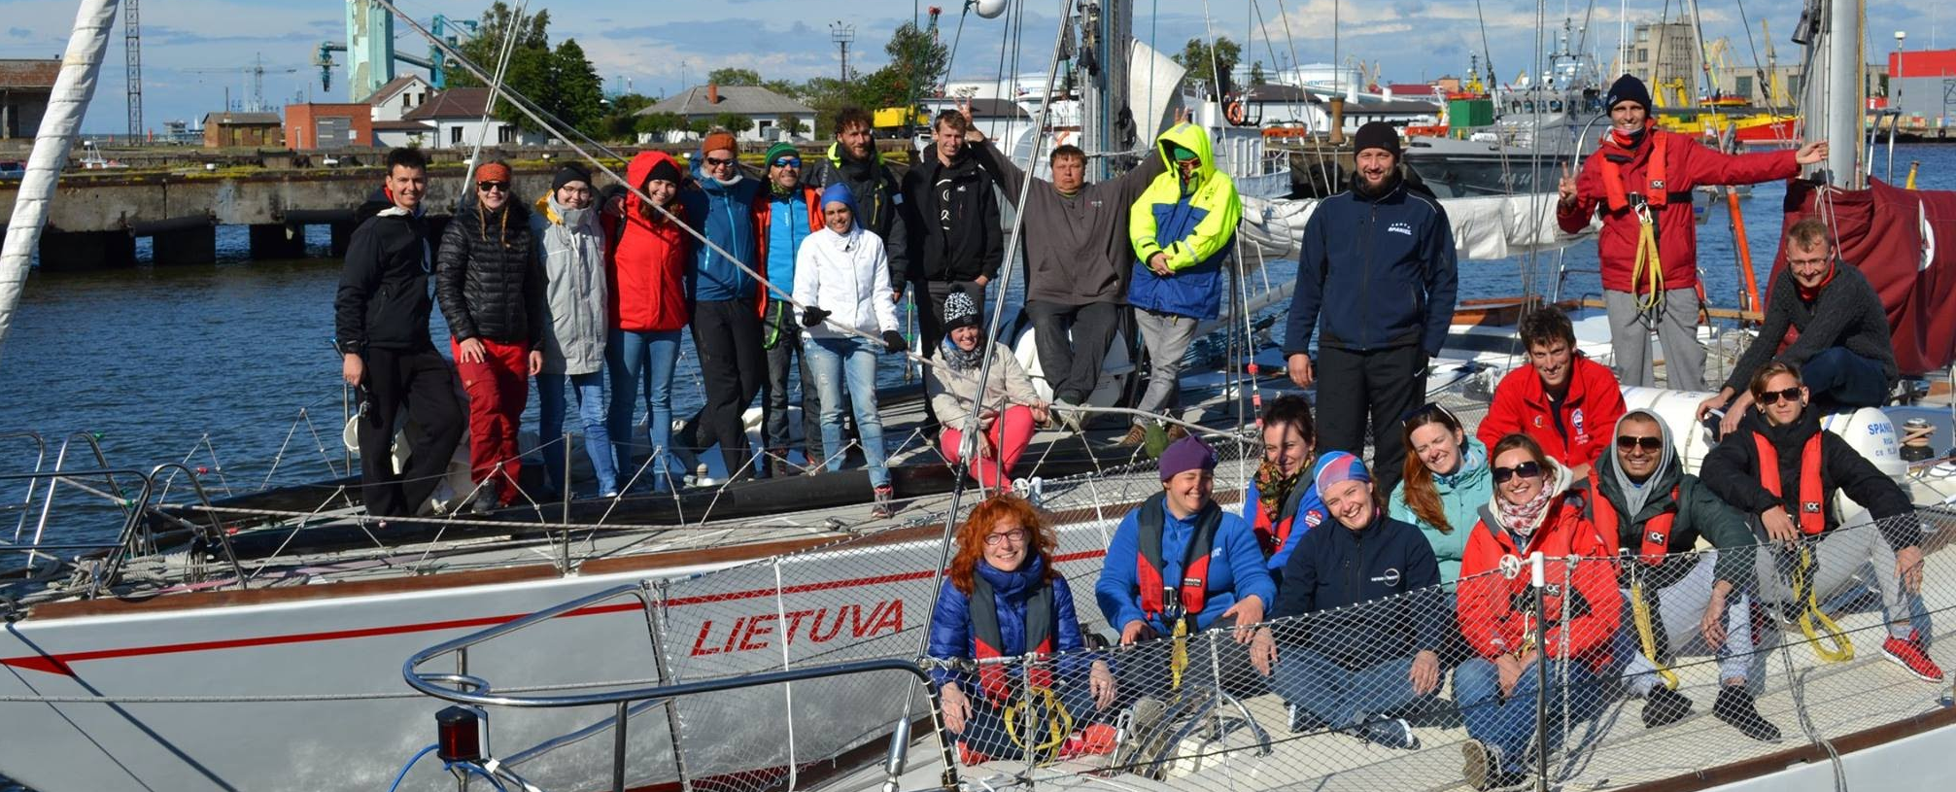
International non-formal education projects
and EU funding

Slide 2
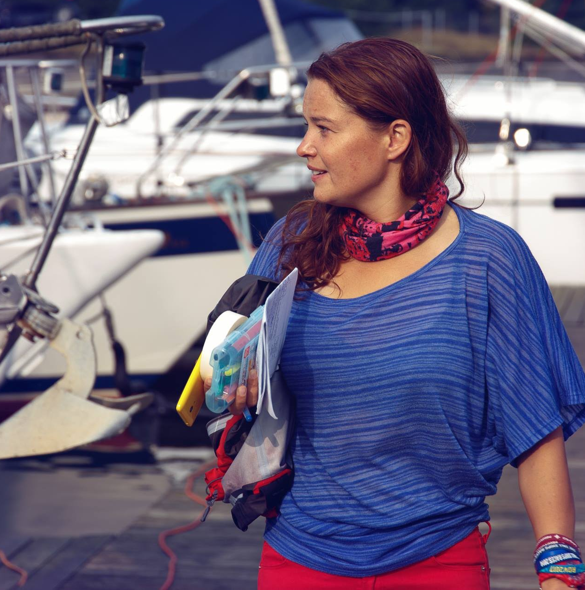
SINTIJA LASE
►Project manager & trainer at STA Latvia
►Sailed 11 000 nm, mostly on s/y SPANIEL
►Organized 6 SAILING YOUTH PROJECTS
#youthSAIL4creativity100 (2017–2018); #SAIL4activeLIFE (2017); #ĀĶIS LŪPĀ (2017);
#SAIL4youth (2016); #SAIL4entrepreneurSHIP (2015); #Next stop: non-formal education (2012)
Since 2011 ►Member of the trainers' pool of Agency for International Programs for Youth: Erasmus+: Youth in Action
Delivered about 50 training courses on:
non-formal education, European Voluntary Service, personal and team development, project management, outdoor education, creativity and intercultural dialogue, communication and social media, coaching, sailing as a method in youth work and entrepreneurship education.
Sintija Lase
sintija.lase@sta-latvia.lv

Slide 3
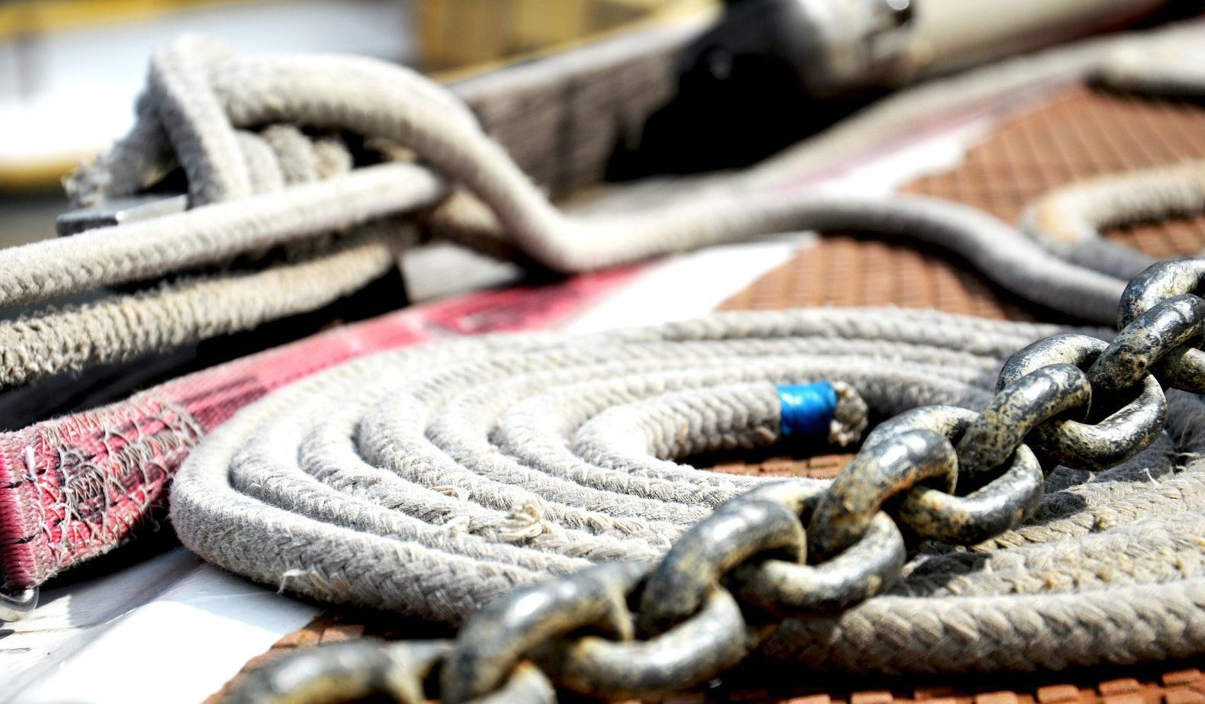
INTRODUCTION
What is your name?
Where are you from? (ship, country, field)
What do you love about sail training?

Slide 4
THE PLAN OF THE SESSION
Introduction
What is non-formal education and
what added value can it bring to sail training?
Tasting & testing non-formal learning methods
Erasmus+: Youth in Action program opportunities
Questions and answers

Slide 5
What is your focus & approach in sail training?
Education
ABOUT sailing
THROUGH sailing
Entertainment/Tourism

Slide 6
What is your focus & approach in sail training?
Education
Skippers’ course
Sailing non-formal eduation projects
ABOUT sailing
THROUGH sailing
Weekend sailing
trip with friends
Passengers on your sailing boat
Entertainment/Tourism

Slide 7
What is your focus & approach in sail training?
Education
Erasmus+ Youth in Action
ABOUT sailing
THROUGH sailing
Entertainment/Tourism

Slide 8
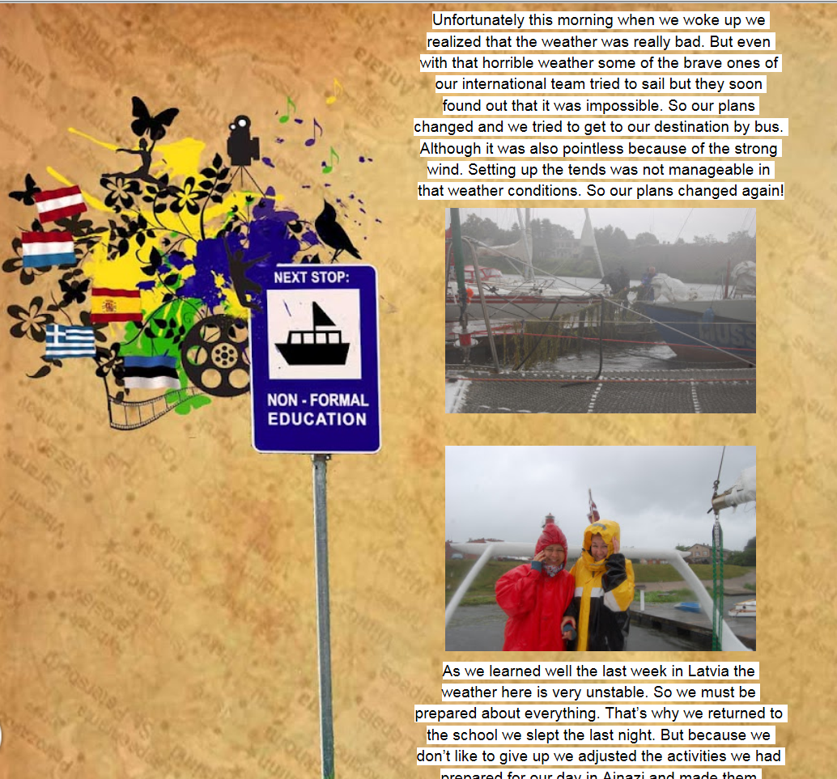
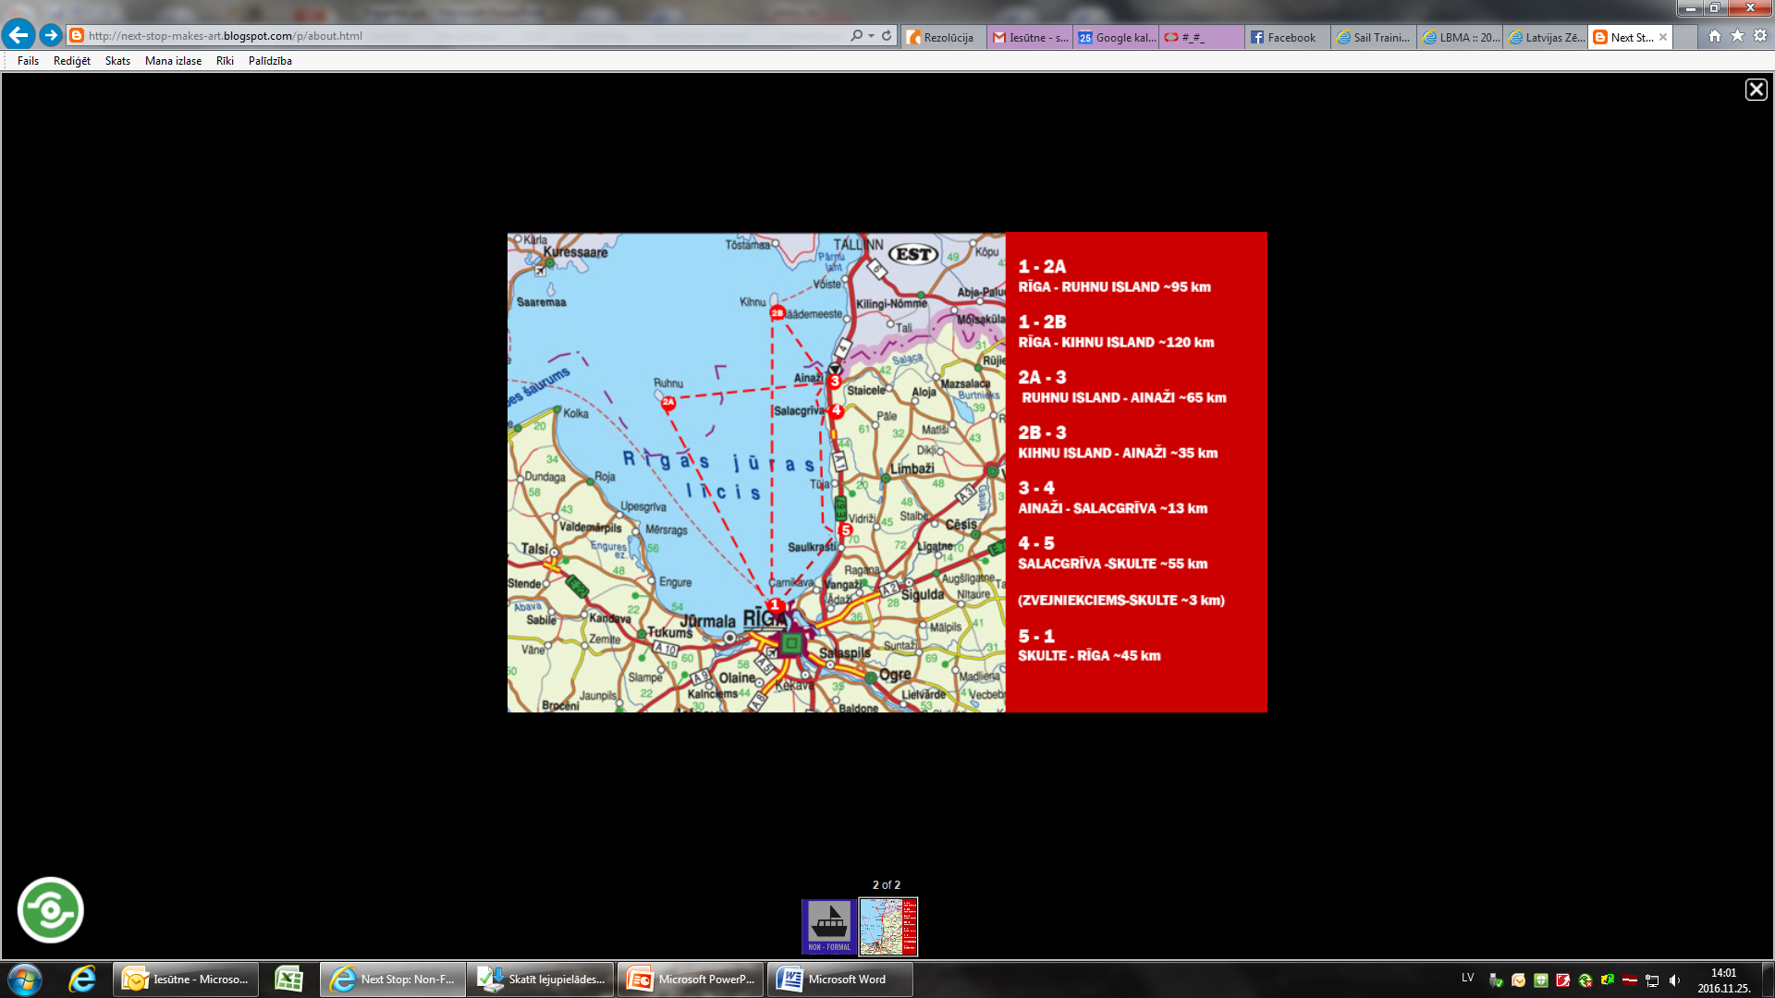
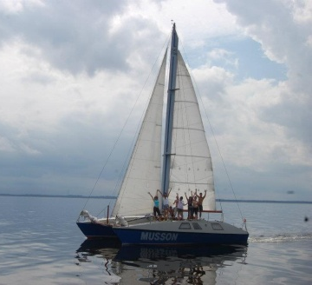
NEXT STOP: non-formal education [2012]
Youth exchange for 20 youngsters from 5 countries (SP, GR, EE, NL, LV)
2 sea catamarans “Tik un tā” & “Musson”
Aim: to promote non-formal education and
leisure time activities for young people
in coastal rural areas.

Slide 9
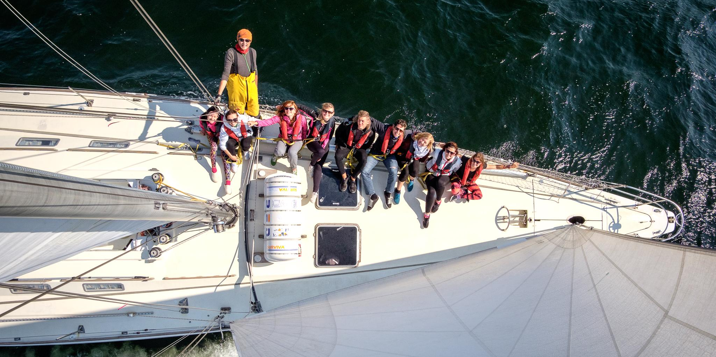

Sail Training Association Latvia (STA Latvia)
& sail training yacht SPANIEL
Participation
in international regattas
International cruises on yacht
Skippers’ course & sea practice
Non-formal education projects
Foto: Andris Kozlovskis

Slide 10
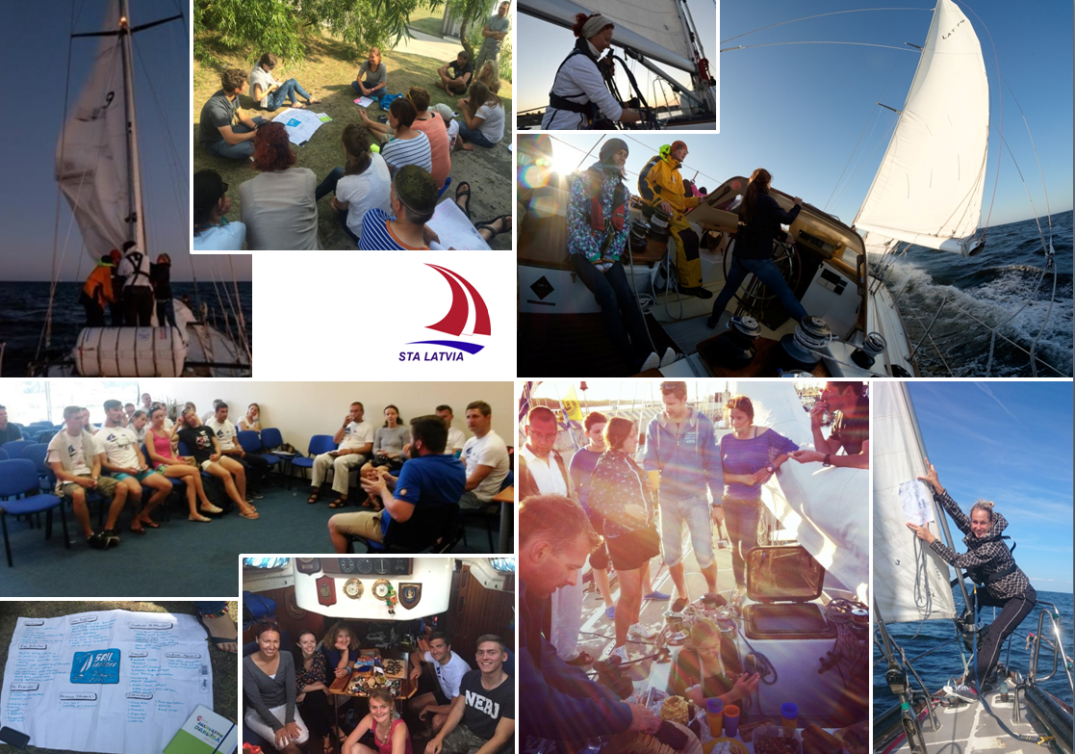
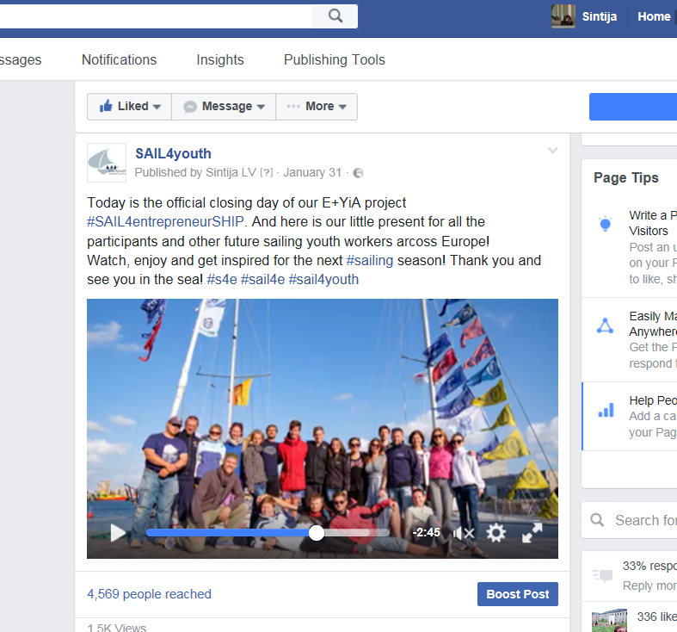



SAIL4entrepreneurSHIP [2015]
Facebook: SAIL4youth
VIDEO: https://www.facebook.com/sail4youth/videos/

Slide 11




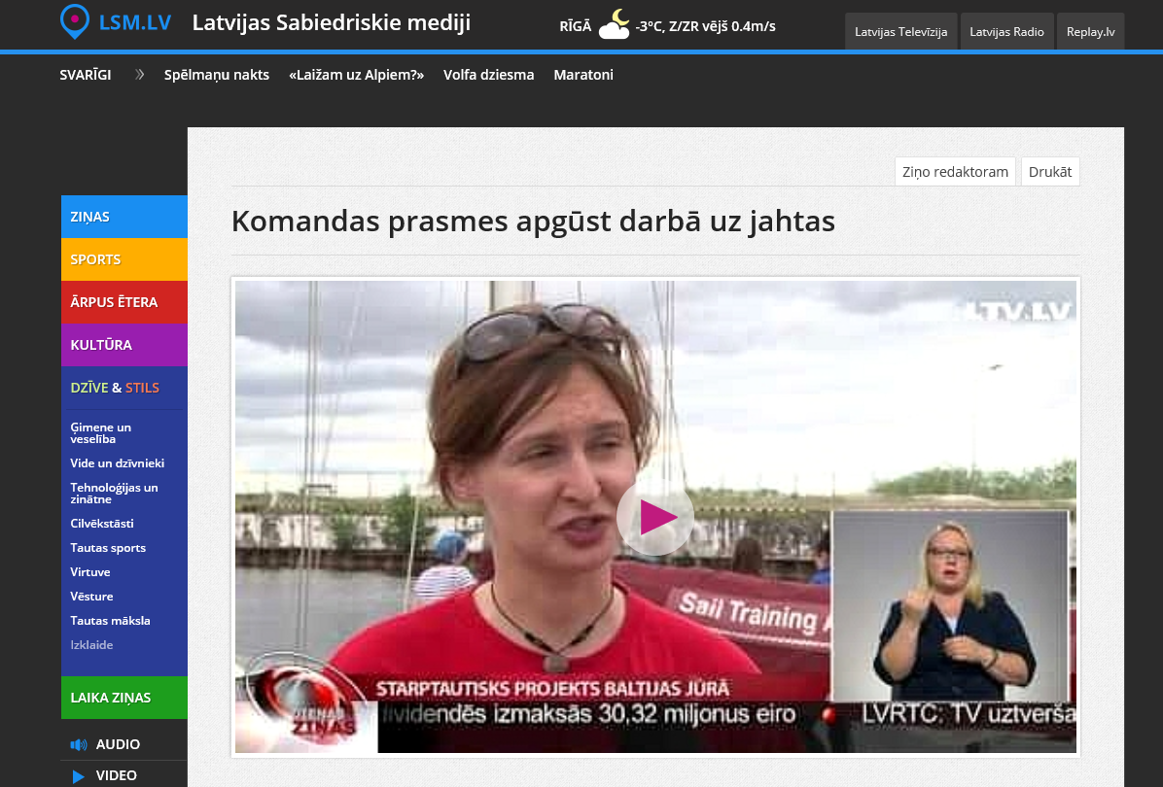
SAIL4youth [2016]
Facebook: SAIL4youth
VIDEO: http://www.lsm.lv/lv/raksts/izklaide/dzive/komandas-prasmes-apgust-darba-uz-jahtas.a188325/

Slide 12
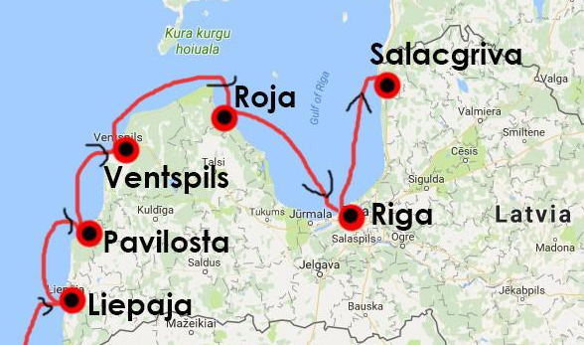
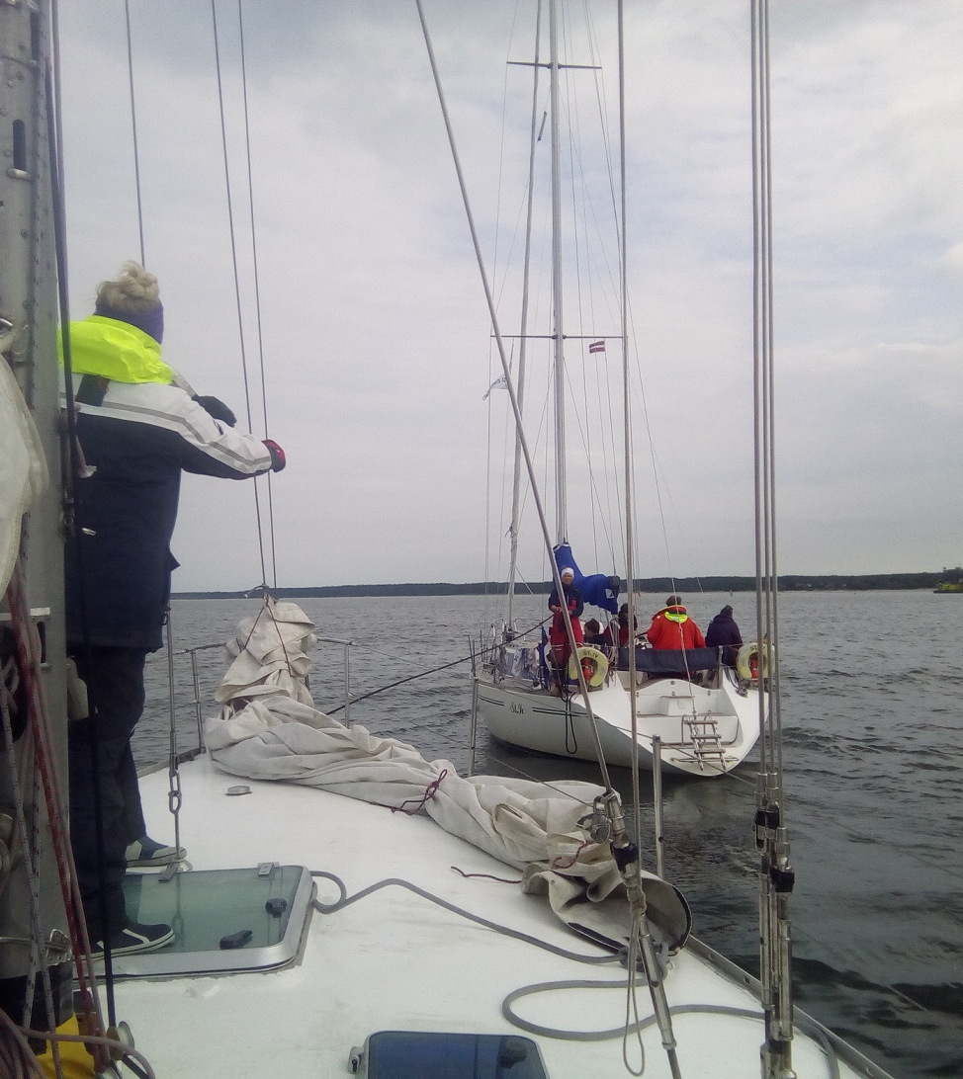
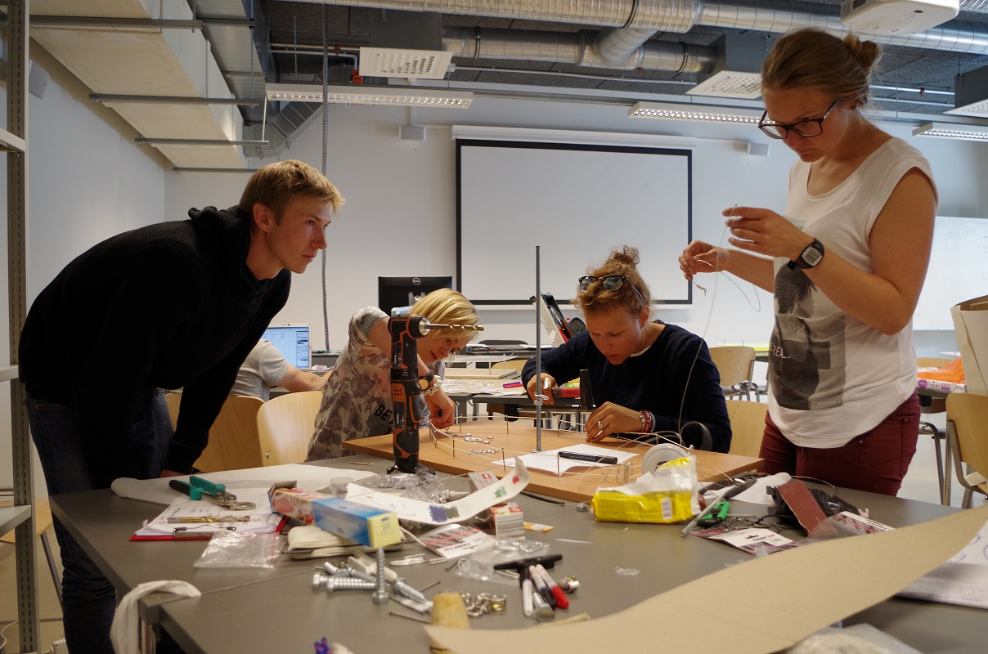
youthSAIL4creativity100 [2017-2018]
26 LV, EE and LT youngsters sailed the coastline of Latvia on 3 yachts and created art exhibition to celebrate 100 years anniversary of Latvia, Estonia and Lithuania.
KA2 “Erasmus+: Youth in Action”

Slide 13
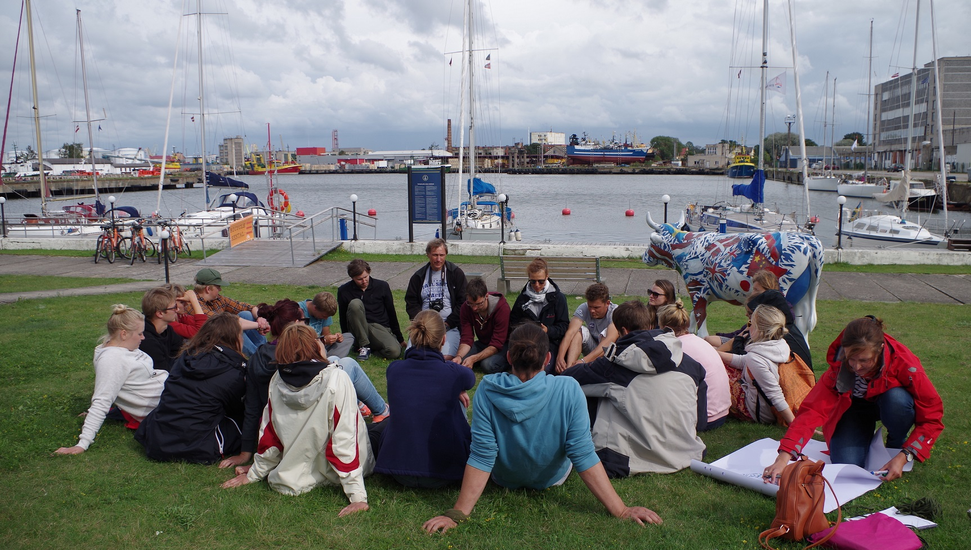
Sail training and youth work

Slide 14
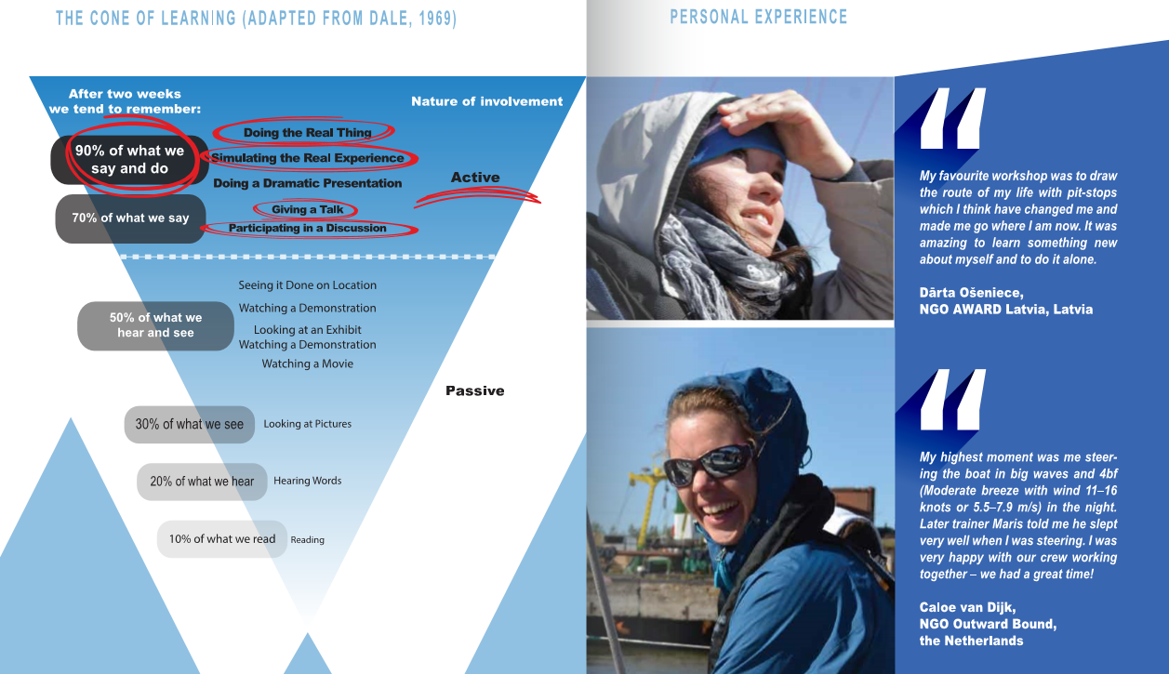
Active learning

Slide 15
Non-formal education
Learning
by doing
Learning
to be with OTHERS
Learning
to learn
Learning
to BE

Slide 16
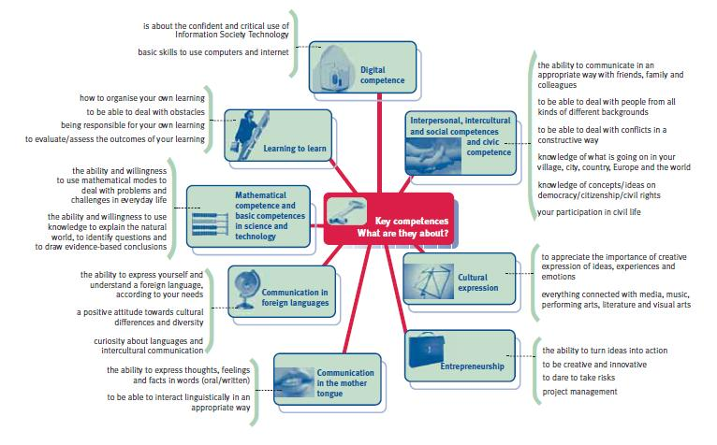

8 life-long learning competences

Slide 17

1
3
Competence =
1) knowledge +
2) skills +
3) attitudes
2

Slide 18

1) EXPERIENCE the activity
– perform, do it
Reflection
2) SHARE the results, actions, observations

Slide 19
1) EXPERIENCE the activity
– perform, do it
Reflection
2) SHARE the results, actions, observations
5) APPLY what was learnt to similar or different situations, practice
3) REFLECT & EVALUATE by discussing, looking at the experience, different roles and moments
4) GENERALIZE to connect the experience to every-day life
Experiential
Learning Cycle

Slide 20
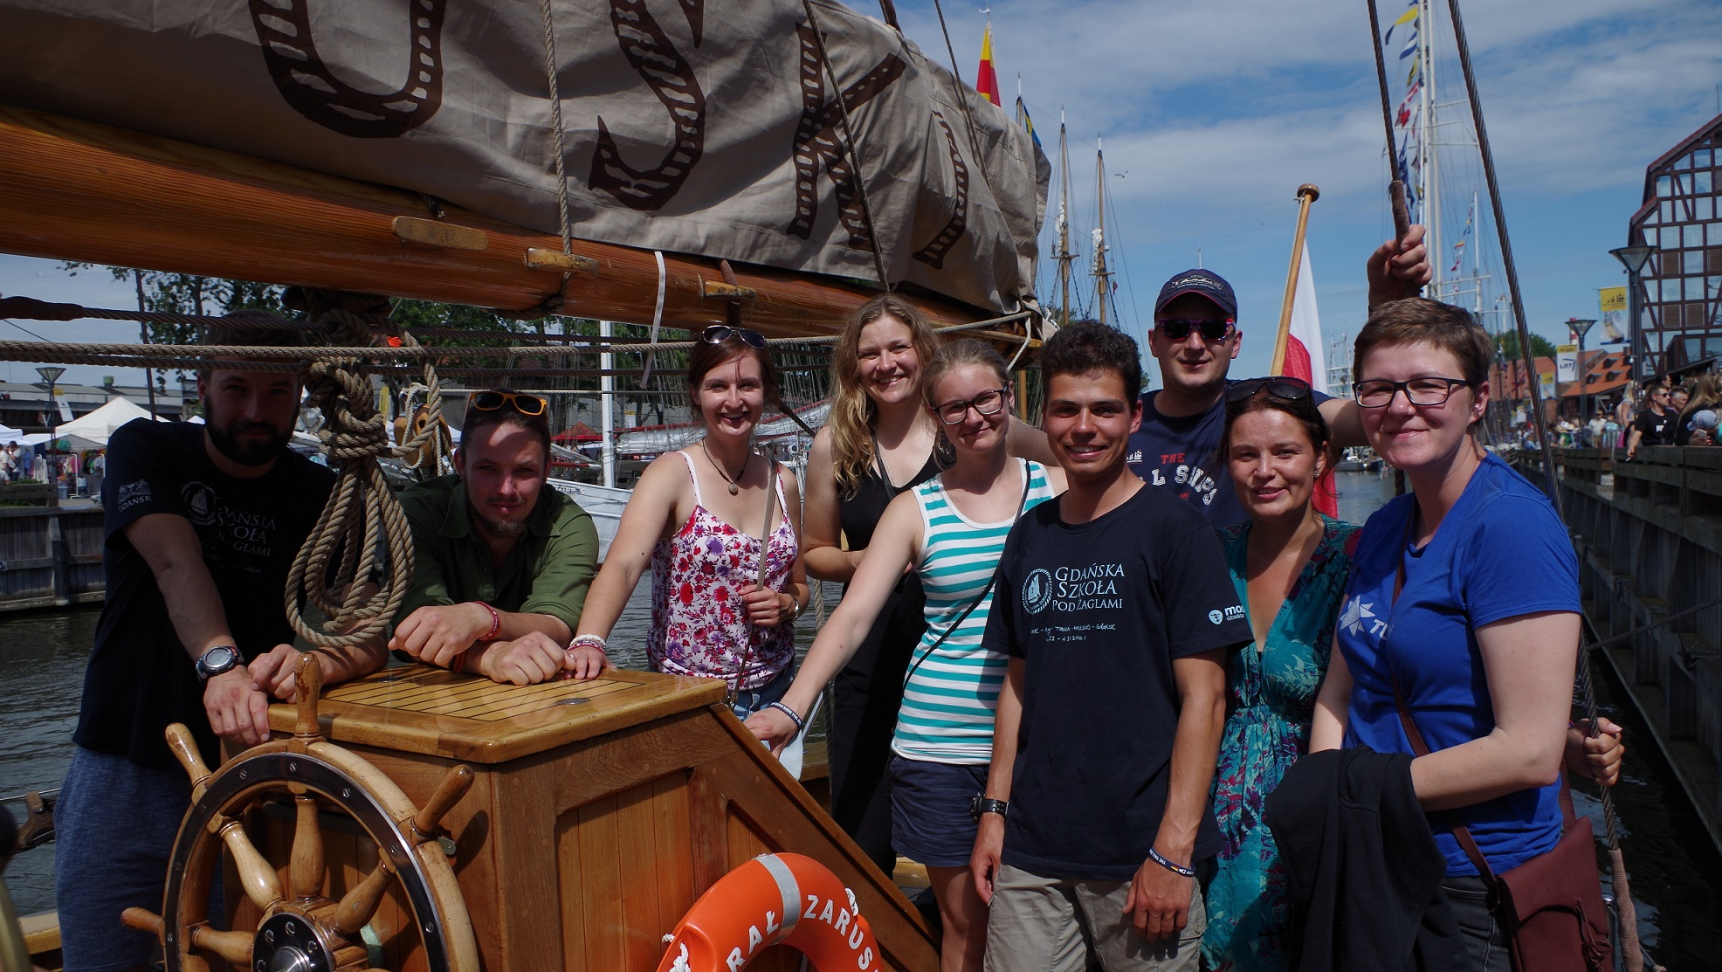
Designing non-formal education program: principles & methods

Slide 21
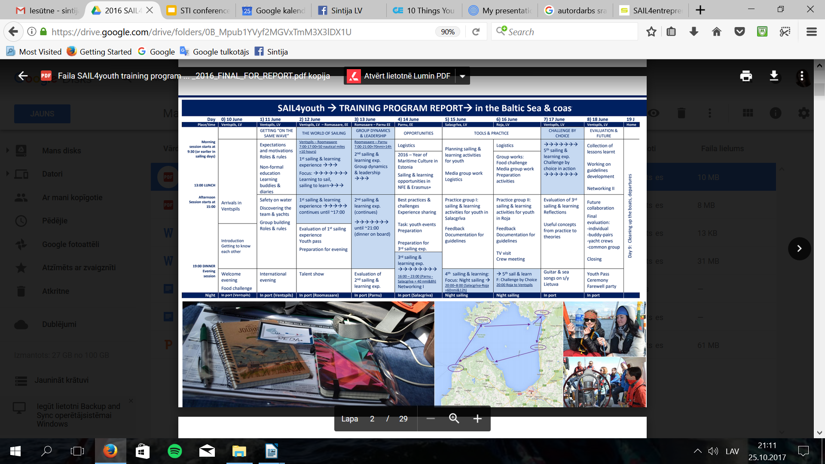

Slide 22
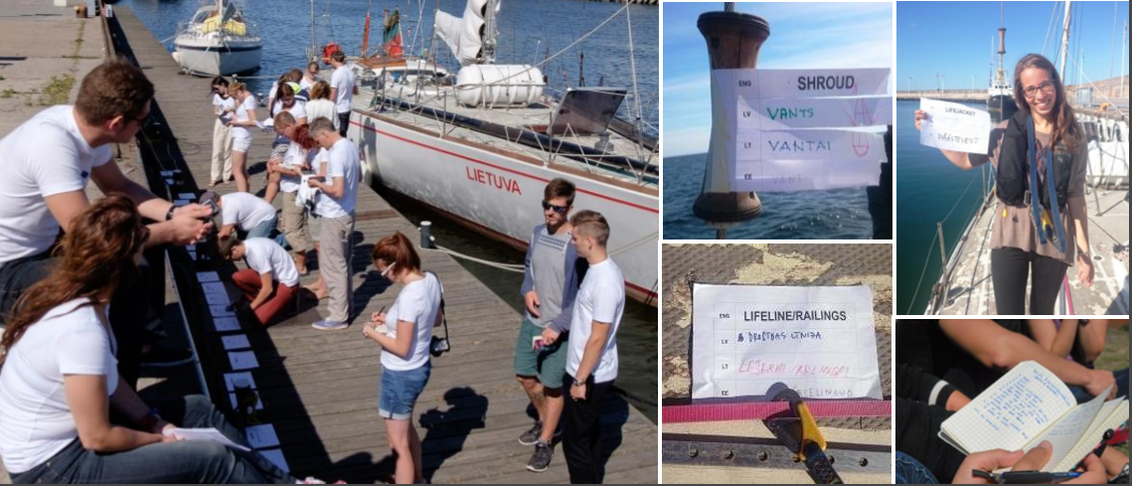
#1 Discovering the ship: creating visual dictionary

Slide 23
Why visual nautical dictionary
People learn about the ship and sailing terms in English
It’s FUN, creative and with high involvement
It involves more than one learning style
It gives need to explore the ship, and in an ACTIVE way (instead of passive excursion and introduction)
It builds supportive learning atmosphere and curiosity
It’s breaking ice and creates safe place to learn
The result can be saved and used after to recall terms, and people knows where is what
The result can be used for visibility (in social networks)
It can be connected to 8 life-learning competences
It helps to formulate the learning goals (you don’t know what to learn before you have explored options)
It gives you the possibility to discover ways to learn when you do not know smth (learning to learn)

Slide 24
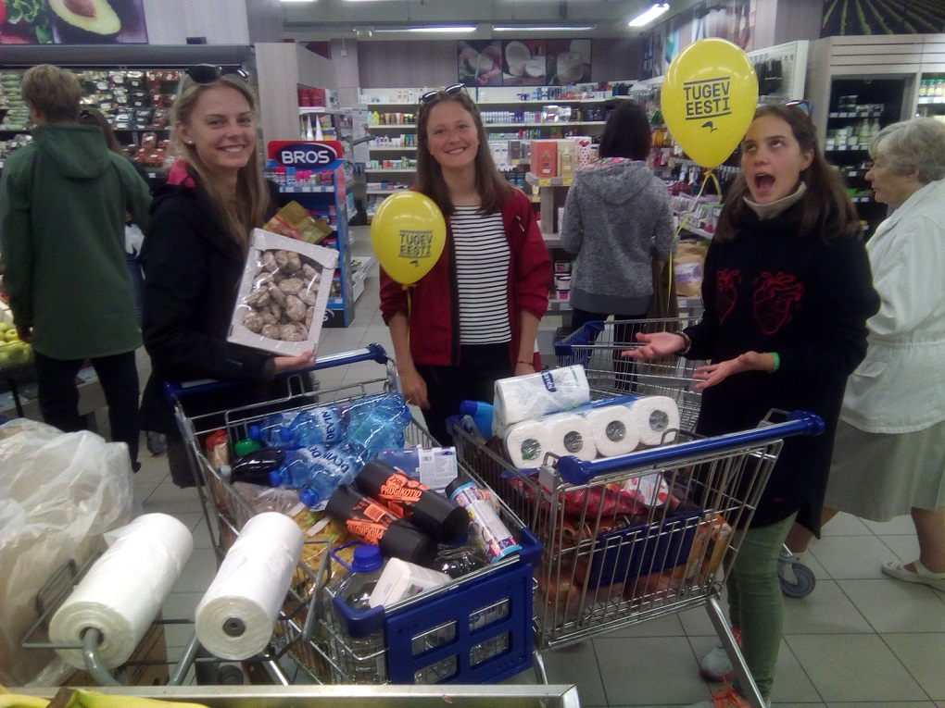
#2 Practical task aboard: Food challenge
Split the group in teams
and give them:
Limited time
Limited budget
Clear period and number of people to feed
Information of what facilities are available on the ship
Tips & map of the town
(where to go)
Evaluate afterwards the process

Slide 25
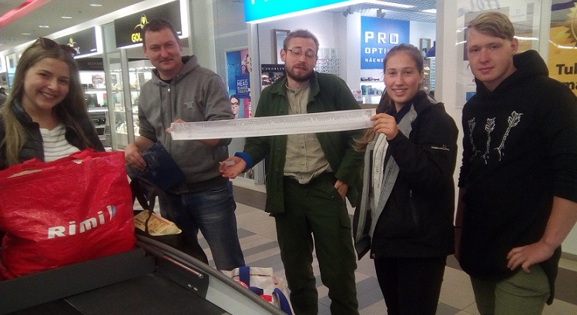
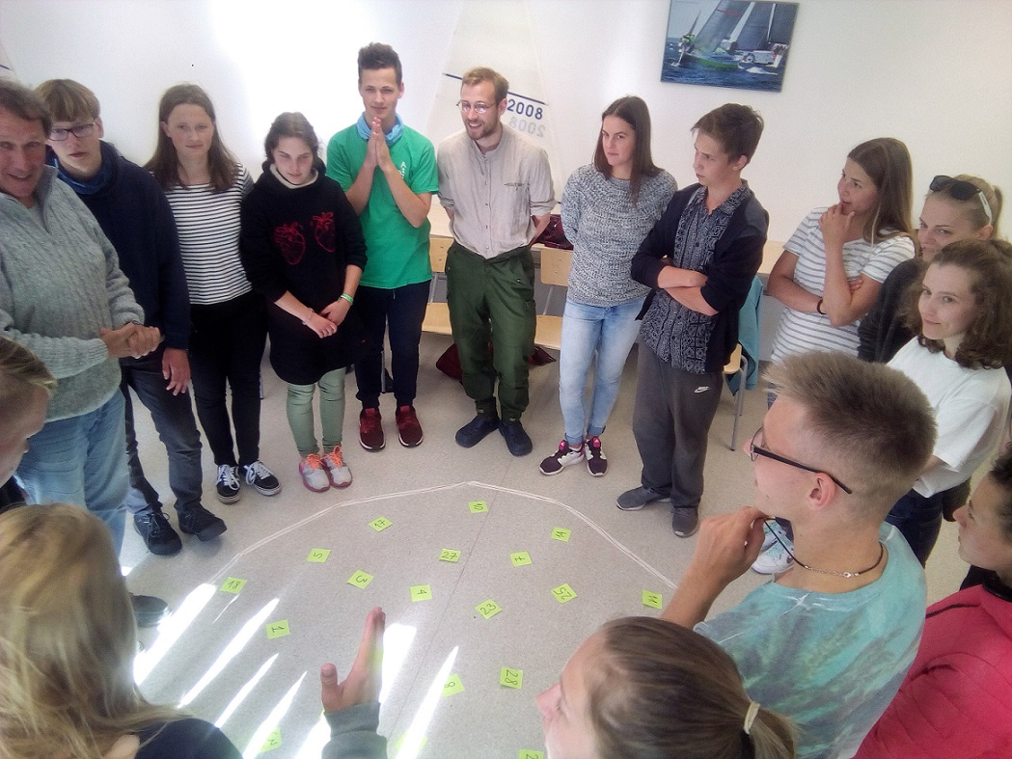
Why Food challenge
We need food aboard
High involvement of everyone
It has very realistic outcome of teamwork
It gives voice for all participants to express their needs therefore taking responsibility what happens aboard
It has gaming elements so the shopping challenge is more attractive, and everyone is involved
It has team-building elements and the result to evaluate: task division, initiative, time management, budget management etc.
It can be connected to 8 life-learning competences, especially mathematical competence and you can learn about balanced diet, planning budget, etc.

Slide 26
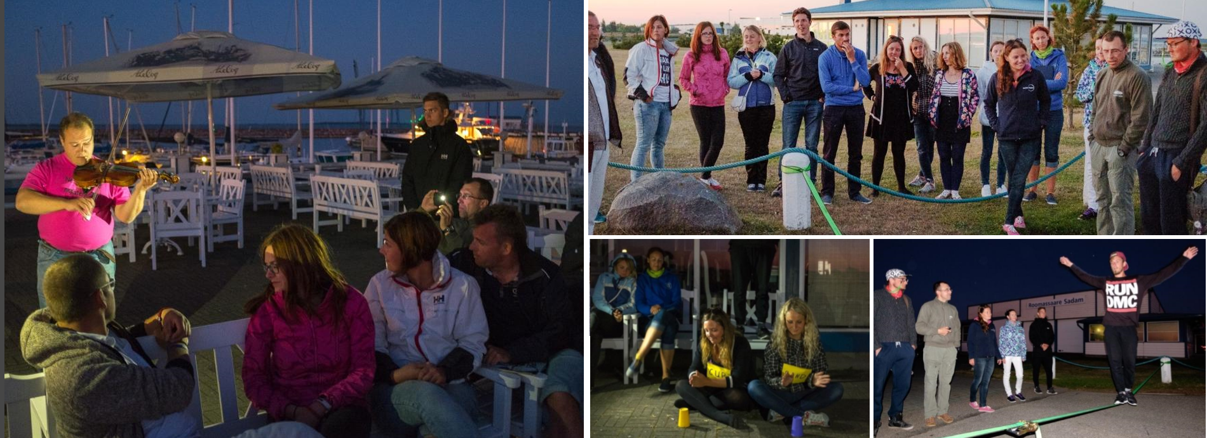
#3 Constructive and fun free time: Talent Show
Give them time and task to prapare a performance to show any of their individual talents.
Moderator of the evening can be picked up from the group to practice public speaking and organizing the event.

Slide 27
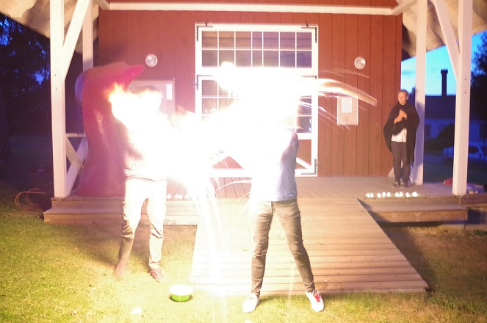
Why Talent Show
To organized thematic evening
High involvement
It’s fun and creative
It gives voice for all participants to express their personalities and get to know each other not only as sailors, but also in other perspectives
It can be connected to 8 life-learning competences, especially cultural awareness and expression, practice public speaking
IMPORTANT: you need to evaluate the process afterwards!

Slide 28


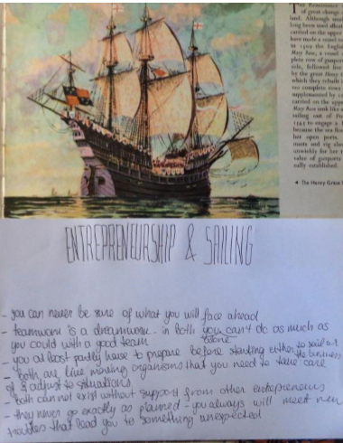
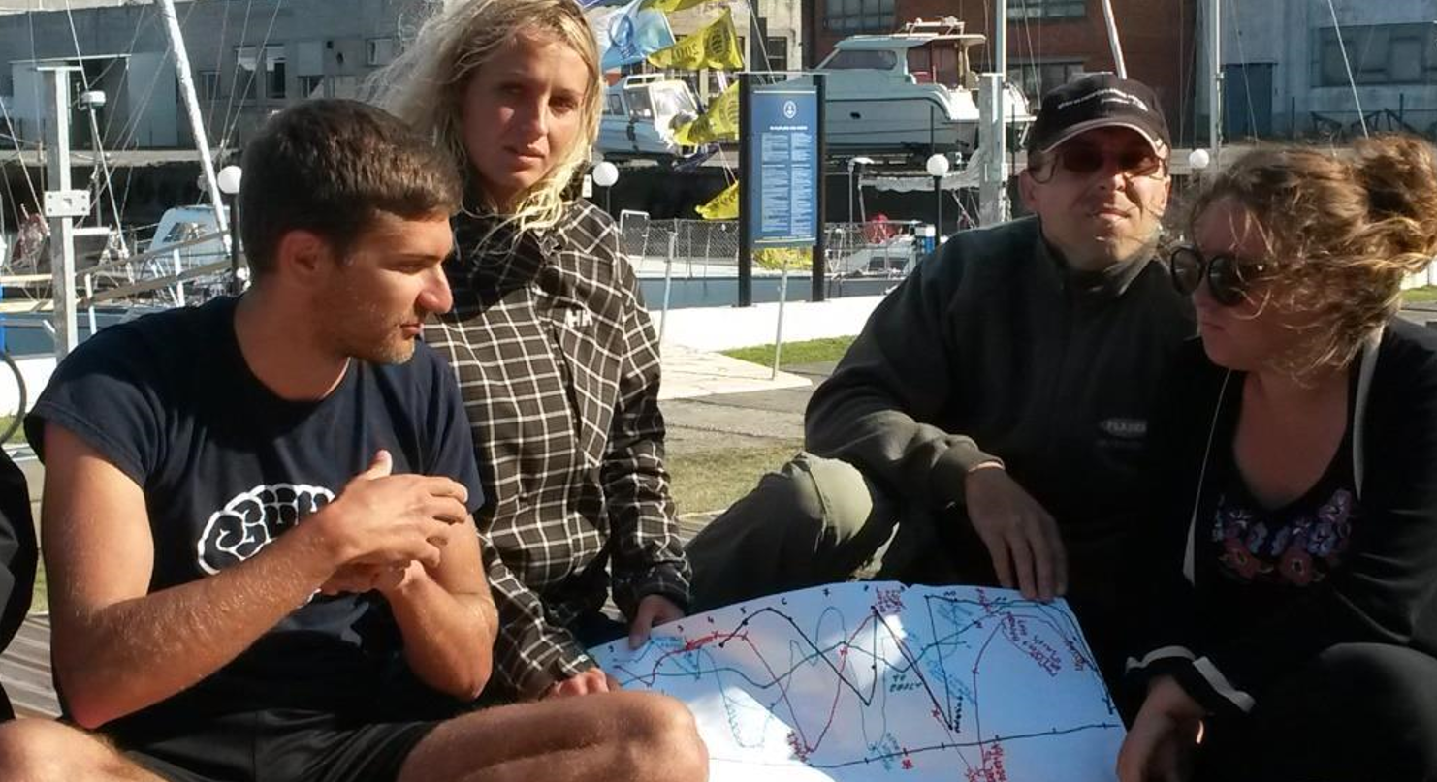
Dislike
#4 Reflection – Evaluation
Learn
Touchy
Fun
LEARNING BUDDIES
Like
IN WATCH/TASK GROUPS
INDIVIDUAL
Short, open, diverse, open, facilitated.

Slide 29
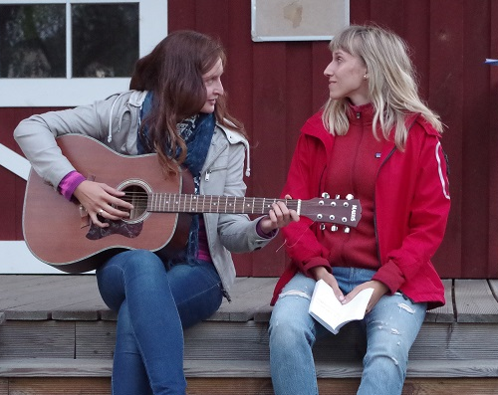
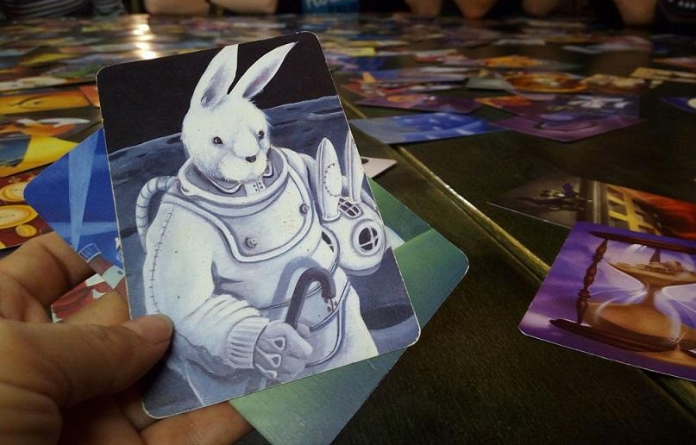
Reflection EXERCISE
1) Choose a learning buddy!
2) Pick a reflection method!
3) Evaluate: how was your sailing season?
4) Share & listen. Make notes of your conclusions & insights!

Slide 30
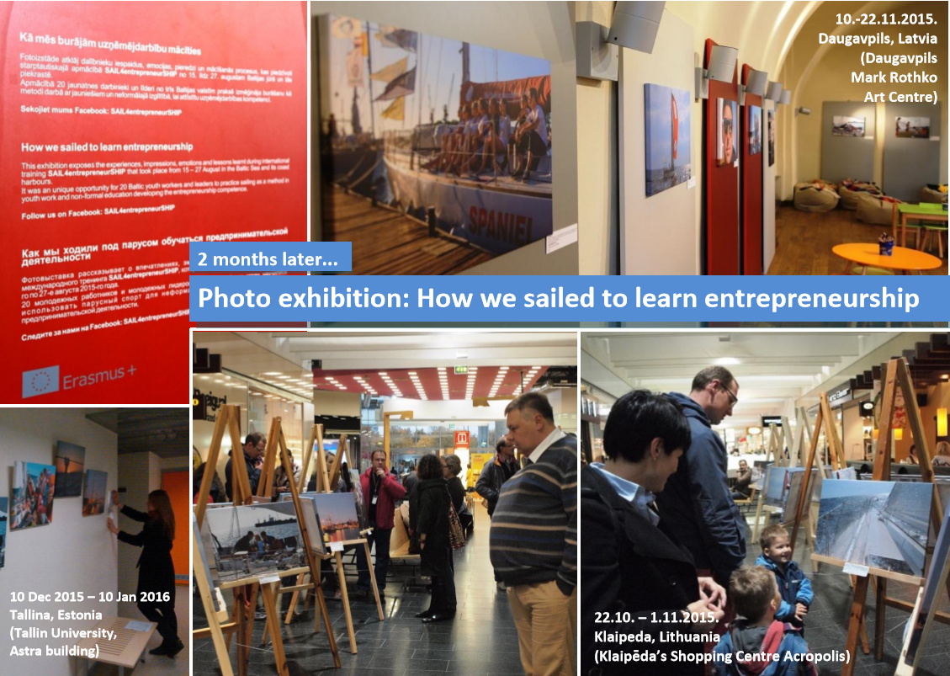
#5
Spreading the results
To keep the group involved over the winter
To promote your brand and programs also between the seasons
To disseminate the results of the project

Slide 31
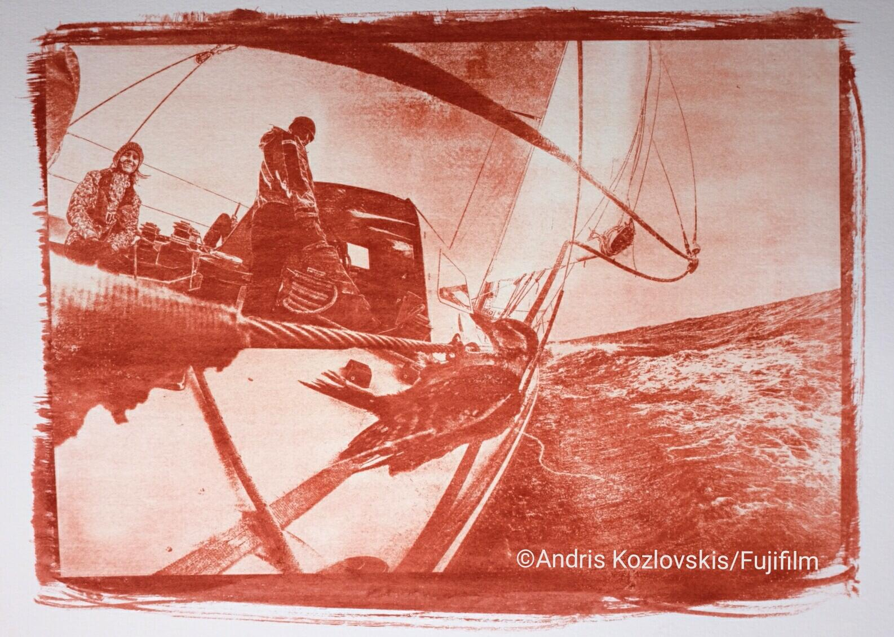
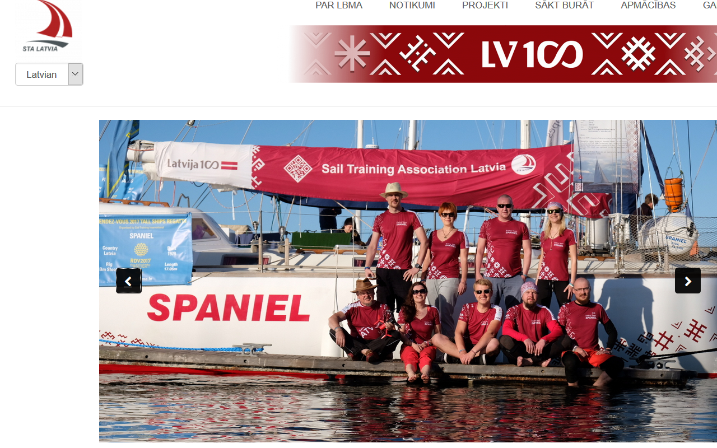
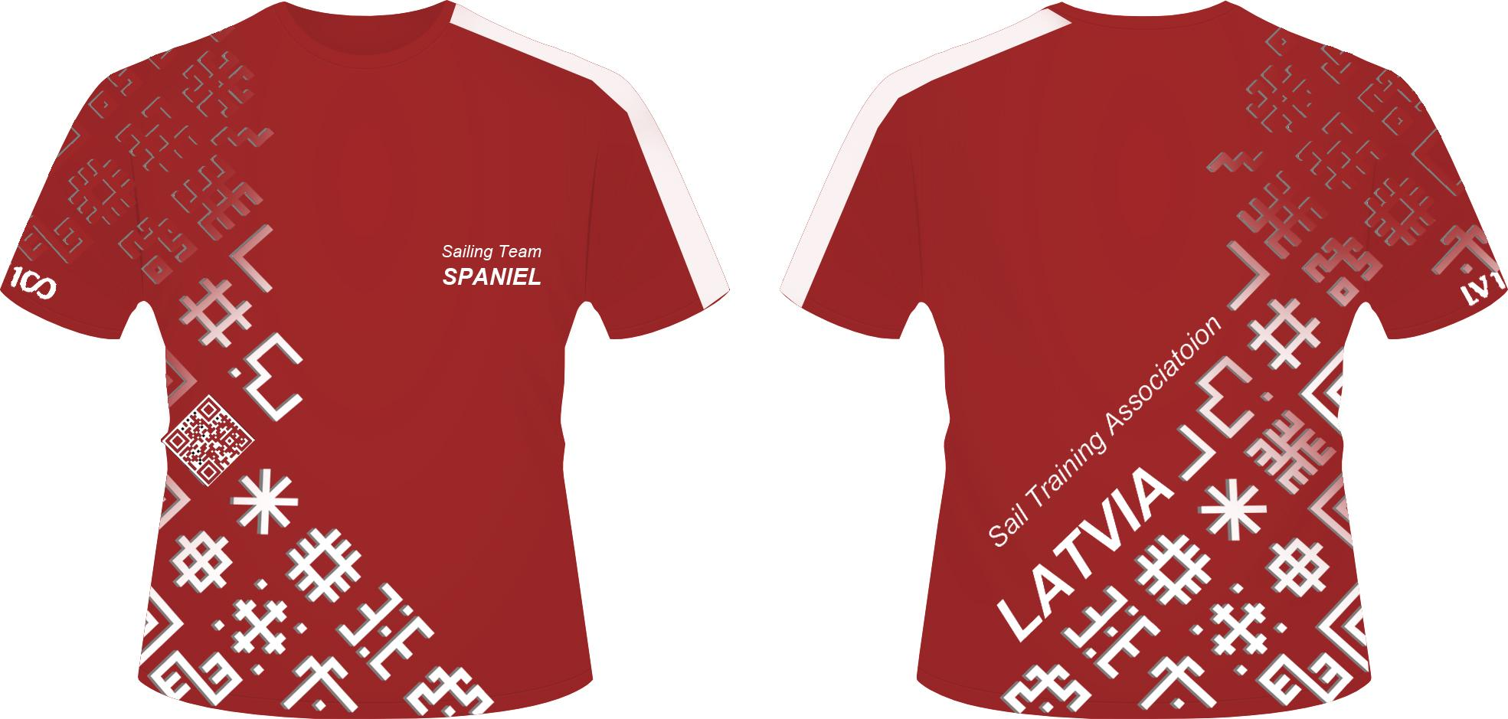
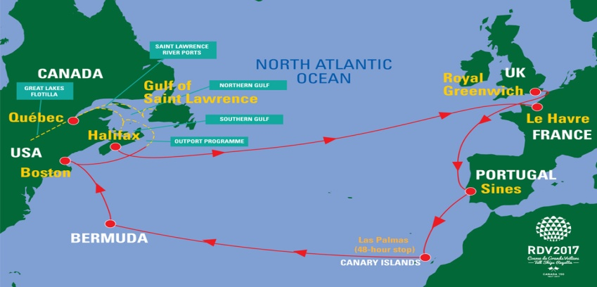
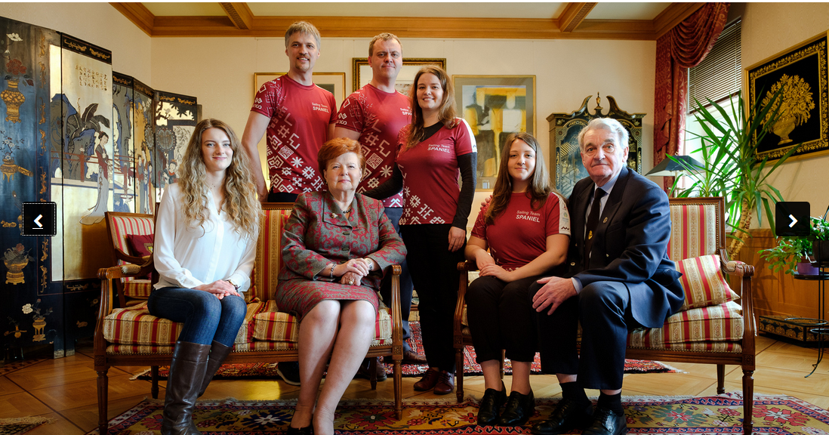
100 years of LATVIA – message across Atlantic Ocean

Slide 32
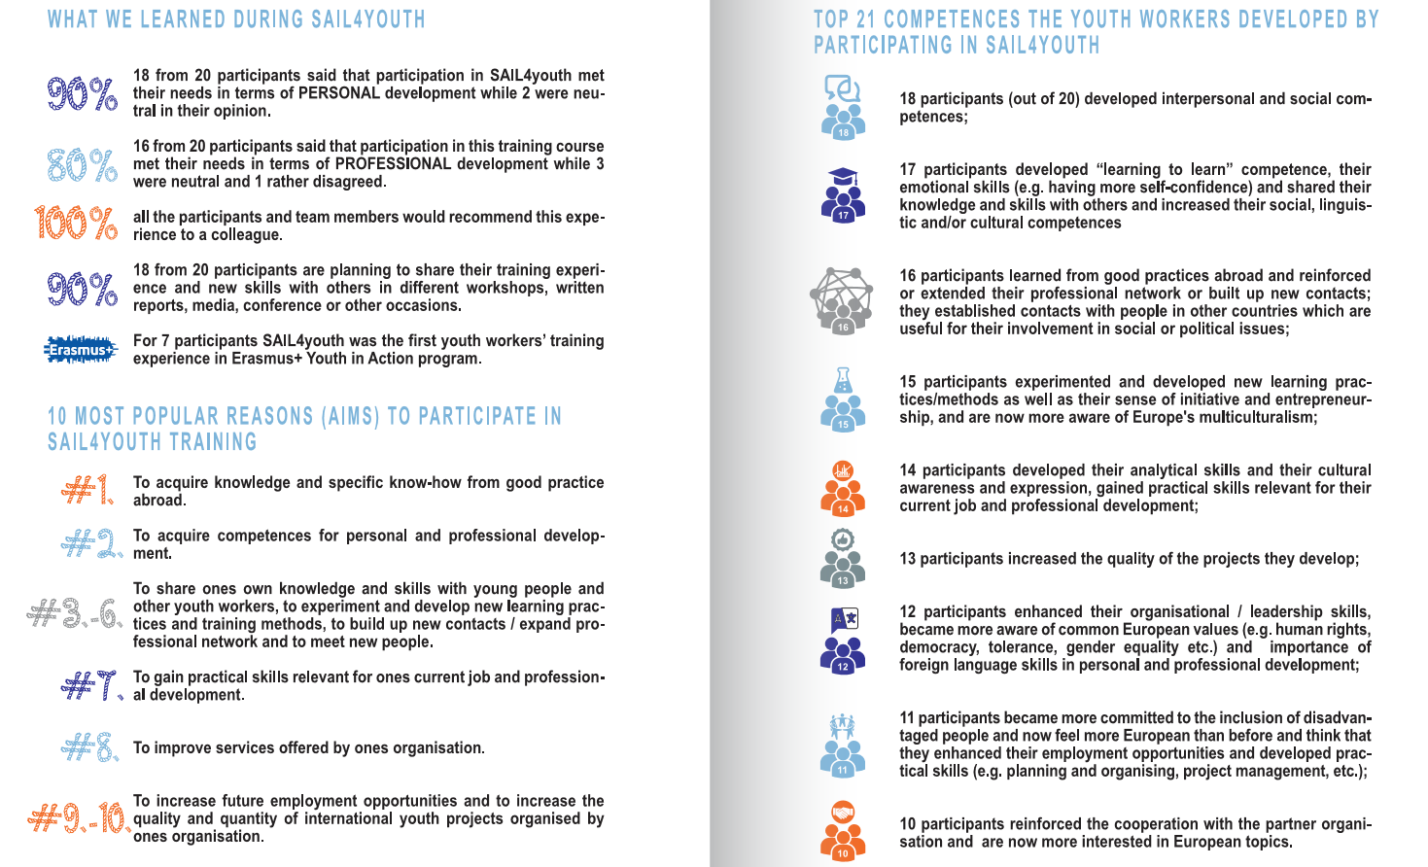
#SAIL4youth impact

Slide 33
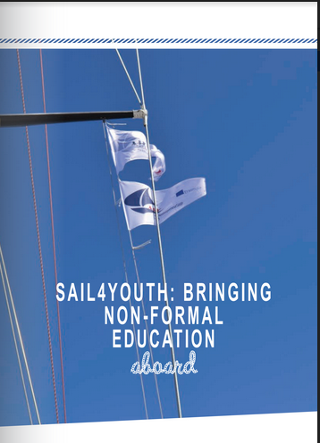
How to design sail training project with non-formal education approach:
http://ej.uz/sail4youthguidelines
Train your crew with your own resources & ideas
Cooperate and apply for common international project under
Erasmus+: Youth in Action program

Slide 34
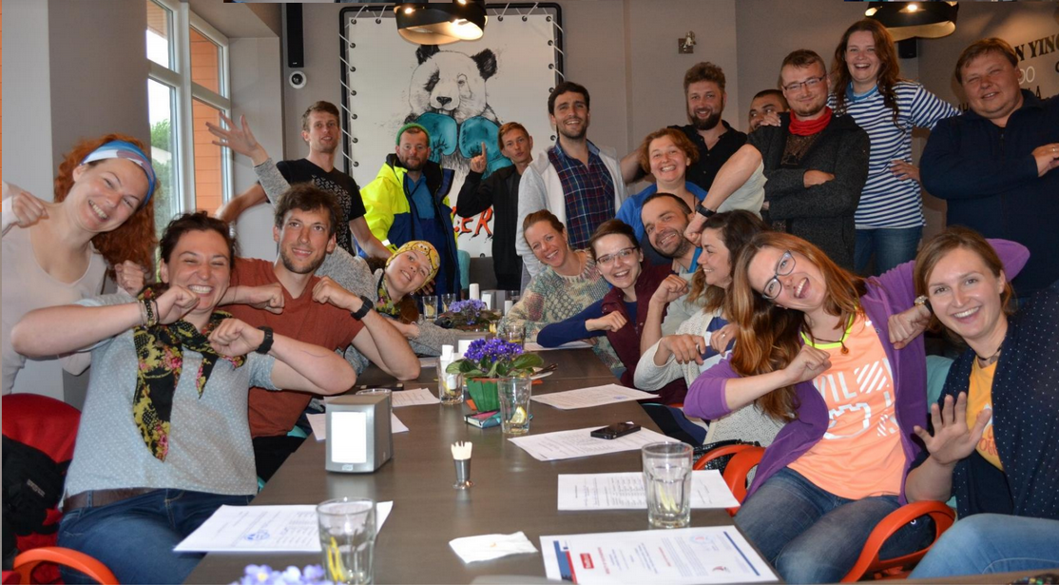
Erasmus+: Youth in Action program

Slide 35
Erasmus+ Youth in Action program
supports non-formal learning in the field of youth
Erasmus+ Sport program (Deadline 6 April, EACEA, Brussels)
☼ participation in sport and physical activity ☼ voluntary activity in sport
☼ education in and through sport, with special focus on skills development
☼ encouraging social inclusion and equal opportunities in sport
KA1: Mobilities of youth (youth exchanges)
KA1: Mobilities of youth workers (training courses)
KA1: European Voluntary Service (long-term volunteers)
KA2: Strategic partnership in the field of youth
Deadlines 2018: 2 Feb ☼ 26 Apr ☼ 4 Oct (National Agencies)

Slide 36
KA1: Mobilities of youth – youth exchanges
Learning through non-formal education
Specific topic (based in EU values & program priorities)
Active youth involvement in all stages of the project (preparation, implementation, evaluation)
For young people (age 13 - 30) + group leaders (any age)
Duration: 5 - 21 days (usually 8 - 14 days)
At least 2 partners from 2 different countries
Min 16 pax - max 60 pax + leaders (1 - 2 per group)
Activities take place in one of the partner countries
Erasmus+ application deadlines 2018: 2 Feb ☼ 26 Apr ☼ 4 Oct

Slide 37
KA1: European Voluntary Service
Volunteering and learning in local community through non-formal education (not for profit)
For young people (age 13 - 30)
Duration: 2 - 12 months
At least 2 partners from 2 countries (sending & hosting)
1 - 30 volunteers per project
Activities take place in one of the partner countries
Erasmus+ application deadlines 2018: 2 Feb ☼ 26 Apr ☼ 4 Oct + EVS accreditation

Slide 38
KA1: Mobilities of youth workers
Youth work related topics (methods, approaches, networking)
For people working with youth (age 18+)
Duration: 2 days - 2 months (training course is 8 - 10 days)
At least 2 partners from 2 different countries
Up to 50 participants
Learning through non-formal education methods, involvement of professional trainers
Activities take place in one of partner country
Erasmus+ application deadlines 2018: 2 Feb ☼ 26 Apr ☼ 4 Oct

Slide 39
BUDGET in Erasmus+ Youth in Action projects
+ TRAVEL COSTS -> fixed sum per pax per project according to distances:
10-99km = 20 EUR ☼ 100-499km = 180 EUR ☼ 500-1999km = 275 EUR
2000-2999km = 360 EUR ☼ 3000-3999km = 530 EUR
+ ACTIVITY COSTS -> fixed sum per pax per day
(depends on country and activity types)
+ EXCEPTIONAL COSTS -> visa, Advanced planning visit for youth exchanges, special support for young people with fewer opportunities.
Erasmus+ application deadlines 2018: 2 Feb ☼ 26 Apr ☼ 4 Oct

Slide 40
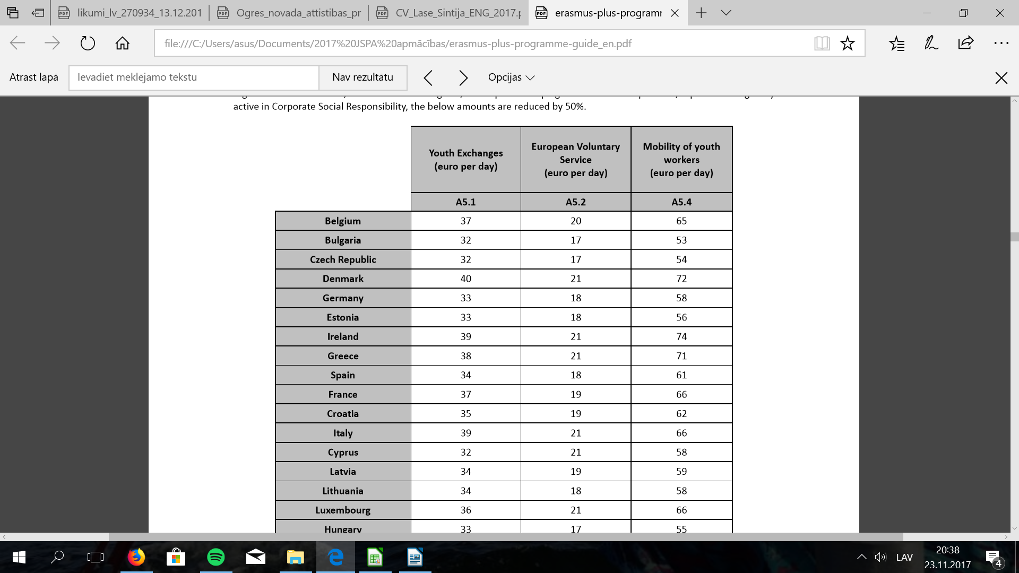
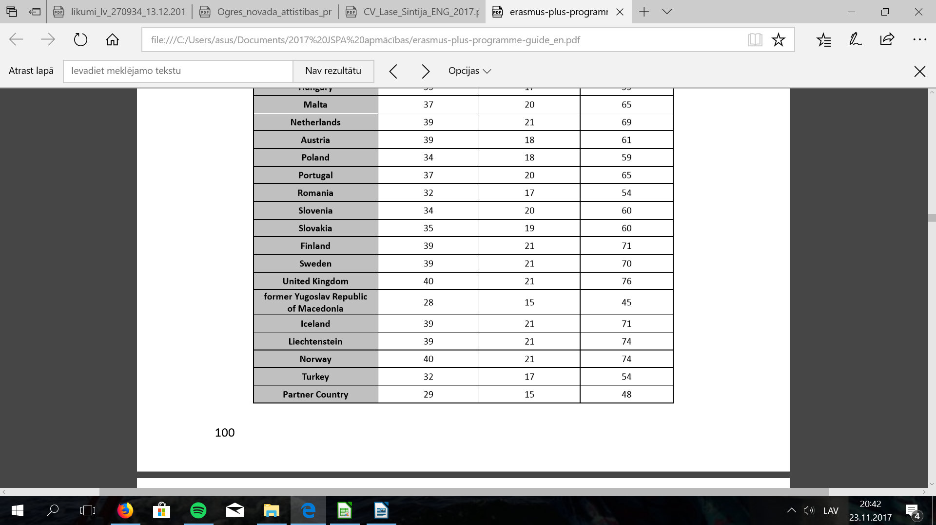
BUDGET in Erasmus+ Youth in Action projects

Slide 41
Erasmus+ Youth in Action application process
PIC code (registration of ECAS account)
Signed mandates from all partners
Application form online
Deadlines 2018: 2 Feb – 26 Apr – 4 Oct
Results - in ~2,5 months
100 % financial cover (no co-funding needed)
80% pre-funding, 20% - after the final report
Consultations in National Agency of program Erasmus+: Youth in Action

Slide 42
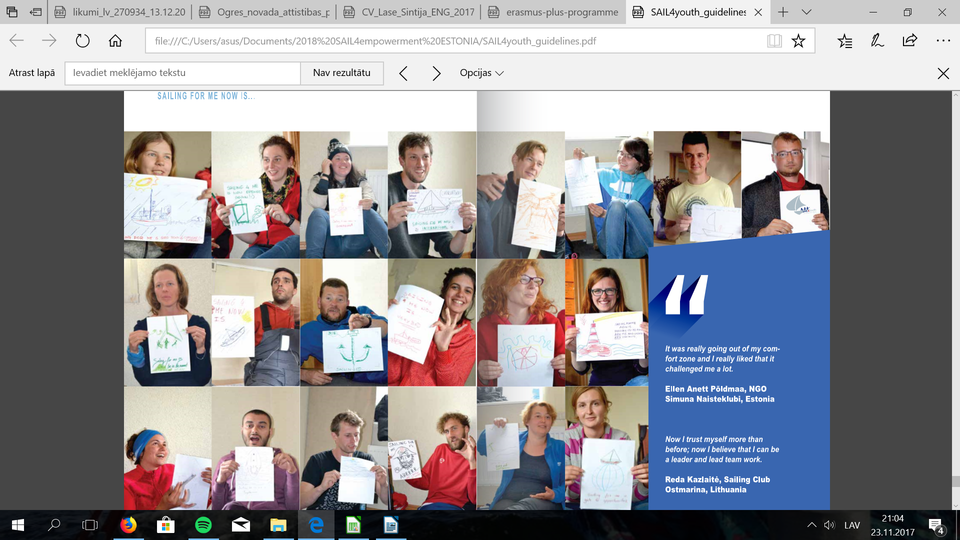
SAILING for me now is...

Slide 43
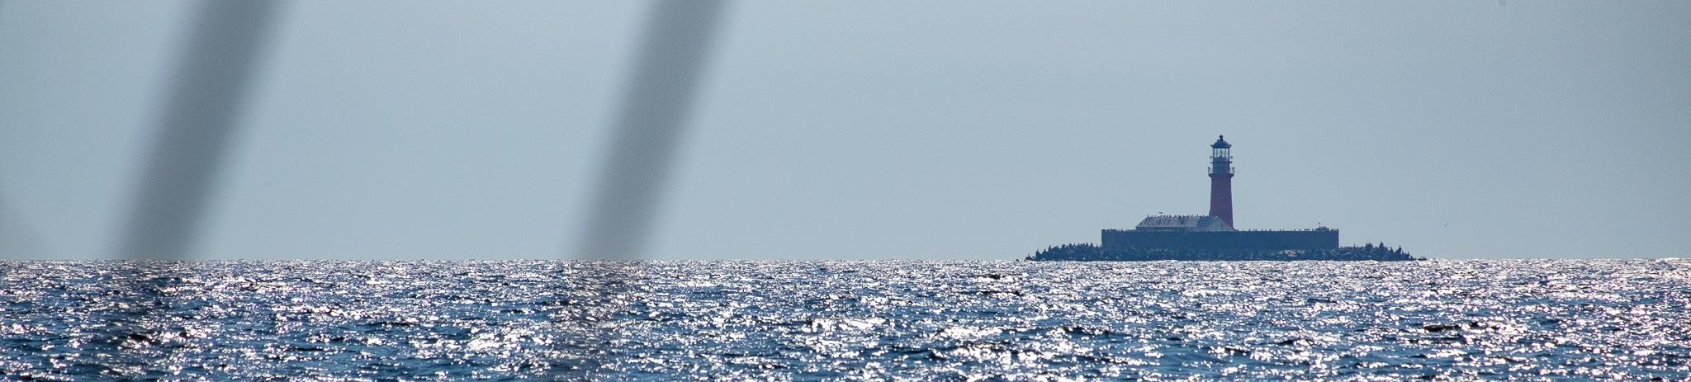
Thank you!
Any questions?

